Slide 1
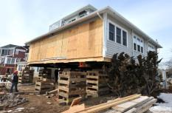
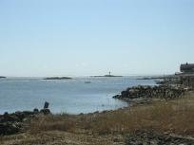
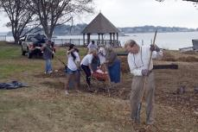
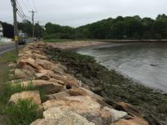
TOWN OF BRANFORD
COASTAL RESILIENCE PLAN
Presentation of the Plan
Janice Plaziak, P.E., Town of Branford
David Murphy, P.E., CFM, Milone & MacBroom, Inc.
Scott Choquette, CFM, Dewberry
Town of Branford, Connecticut | May 3, 2016

Slide 2
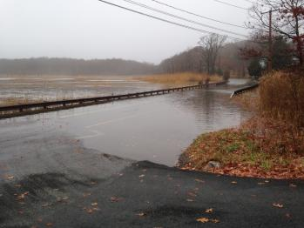
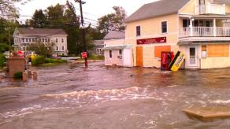
Review
Recommend
Discussion
Plan
Townwide
Access
Region
Conclusions
Next
Plans
Presentation Agenda
Plan Overview
Review
Resilience
Adaptation
Recommendations
Townwide
Access
Region-Specific
Planning Examples
Neighborhood Concepts
Infrastructure Designs
Conclusions
Next Steps
Discussion

Slide 3
Review
Recommend
Discussion
Plan
Townwide
Access
Region
Conclusions
Next
Plans
The Plan: Where we Are
Done
Review Existing Capabilities
Coordinate with “Regional Framework”
Data Collection
Vulnerability and Risk Assessment
Public Information Meetings, Surveys
Select Sandy-Impacted Neighborhoods
Coastal Resilience Plan
Implementation Plan and Process
Spring
Winter
Winter
Now
Now
Done
Done
Done
Spring
Conceptual Designs
Review of Adaptation Options
Notes:
Coastal Resilience Plan Document
Combinations of coastal hazard mitigation, adaptation, and resilience solutions at the locations that are highlighted in Task 7, as well as strategies and actions for the entire town

Slide 4
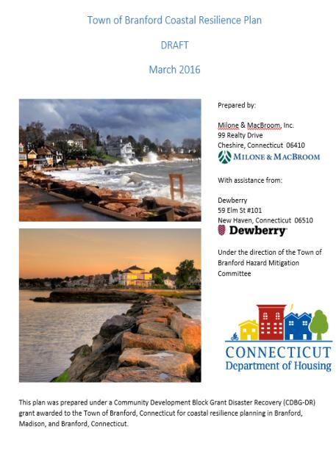
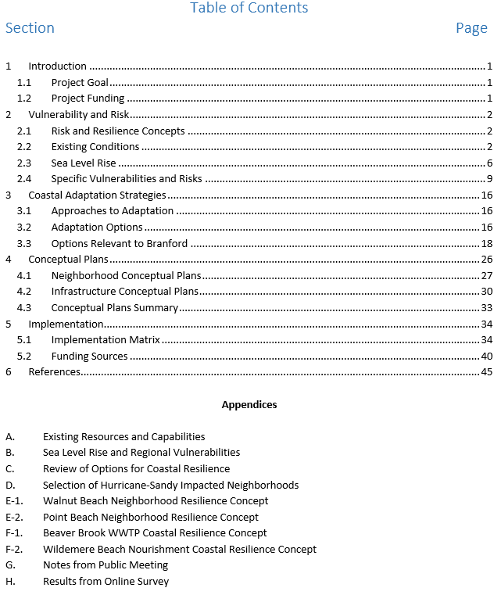
Review
Recommend
Discussion
Plan
Townwide
Access
Region
Conclusions
Next
Plans
The Plan

Slide 5
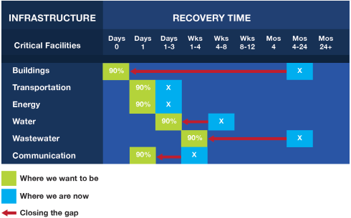
Review
Recommend
Discussion
Plan
Townwide
Access
Region
Conclusions
Next
Plans
Review: Resilience
Prepare
Adapt
Withstand
Recover
Reduce Recovery Time
Decrease Damage
Increase Capacity
Event!
Initial
Recovery
Improved
Recovery
Prepare
Withstand Less Damage
Faster Recovery
Greatest Loss
Community Capacity
Initial Greatest Loss
Time →

Slide 6
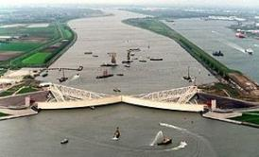
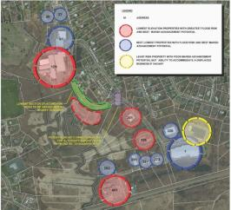
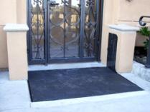
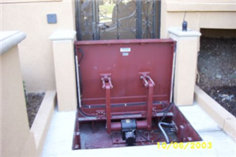
Review
Recommend
Discussion
Plan
Townwide
Access
Region
Conclusions
Next
Plans
Review: Adaptation
NOAA 7 Categories (2010)
Identify and Assess Impacts
Awareness and Assistance
Manage Development
Reduce Losses
Manage Shoreline
Manage Coastal Ecosystem
Manage Water Resources
IPCC: 3 Approaches (1990)
Retreat
Accommodation
Protection
Regional
Scale
Site-Specific Scale

Slide 7
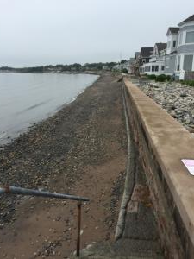
Review
Recommend
Discussion
Plan
Townwide
Access
Region
Conclusions
Next
Plans
Recommendations
Category | Specific Options
Hard Protection | Seawalls
 | Bulkheads
 | Revetments
 | Dikes
 | Groins
 | Breakwaters
Soft Protection | Beach Nourishment
 | Dune Restoration
Hybrid Protection | Bioengineered Banks
 | Artificial Reefs
Infrastructure | Drainage Improvements
 | Road Elevation
 | Wastewater Treatment Plant Floodproofing
 | Sewer Pumping Station Floodproofing
 | Community Wastewater
 | Strengthen Power Utilities
 | Tide Gate Maintenance
Home Protection | Elevation
Regulatory Tools | Flood Damage Prevention : Freeboard V zone standards in Coastal A zones
 | Zoning Modifications: Height Limit Flexibility Reconstruction Flexibility
Coastal Realignment | Road Retirement
 | Alternate Egress Development
 | Property Acquisitions

Slide 8
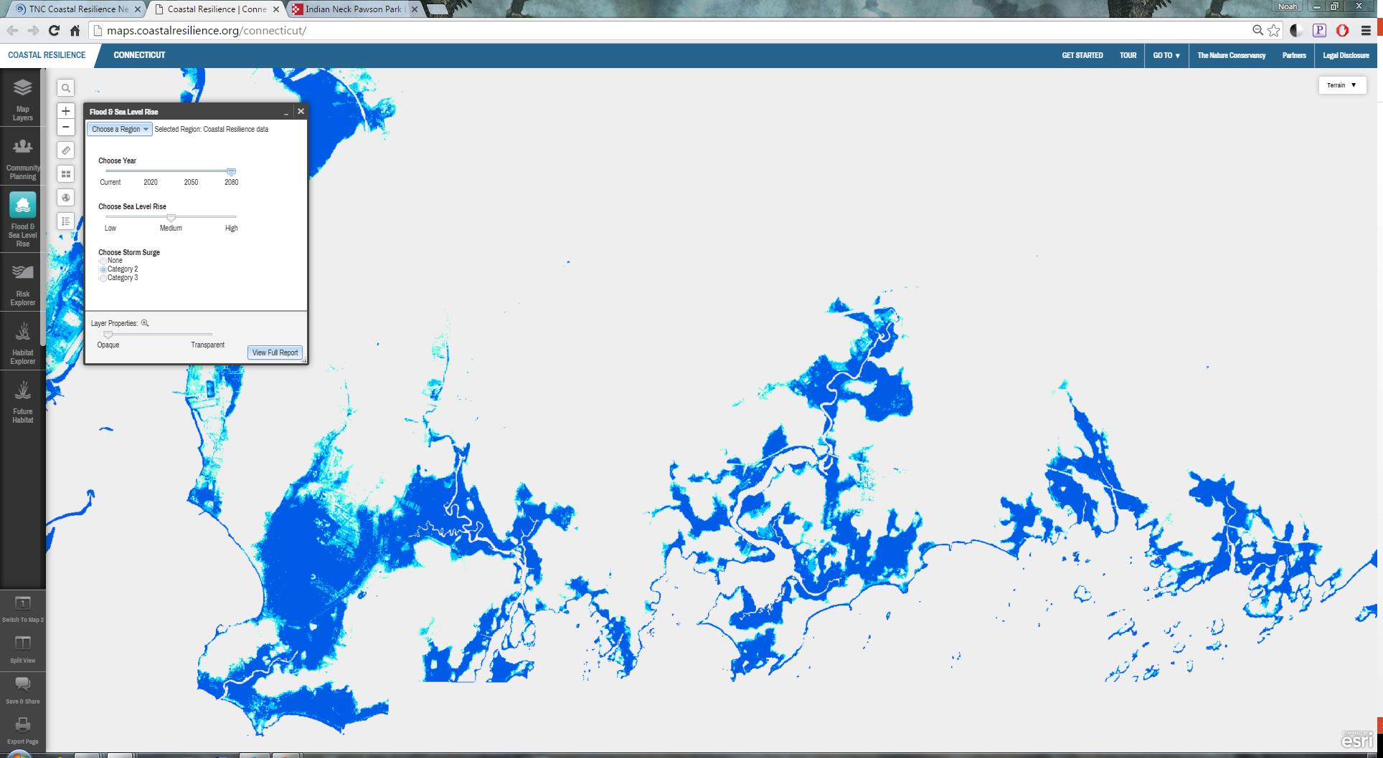
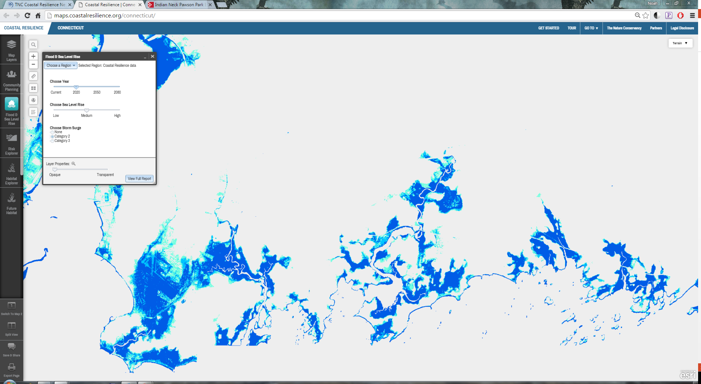
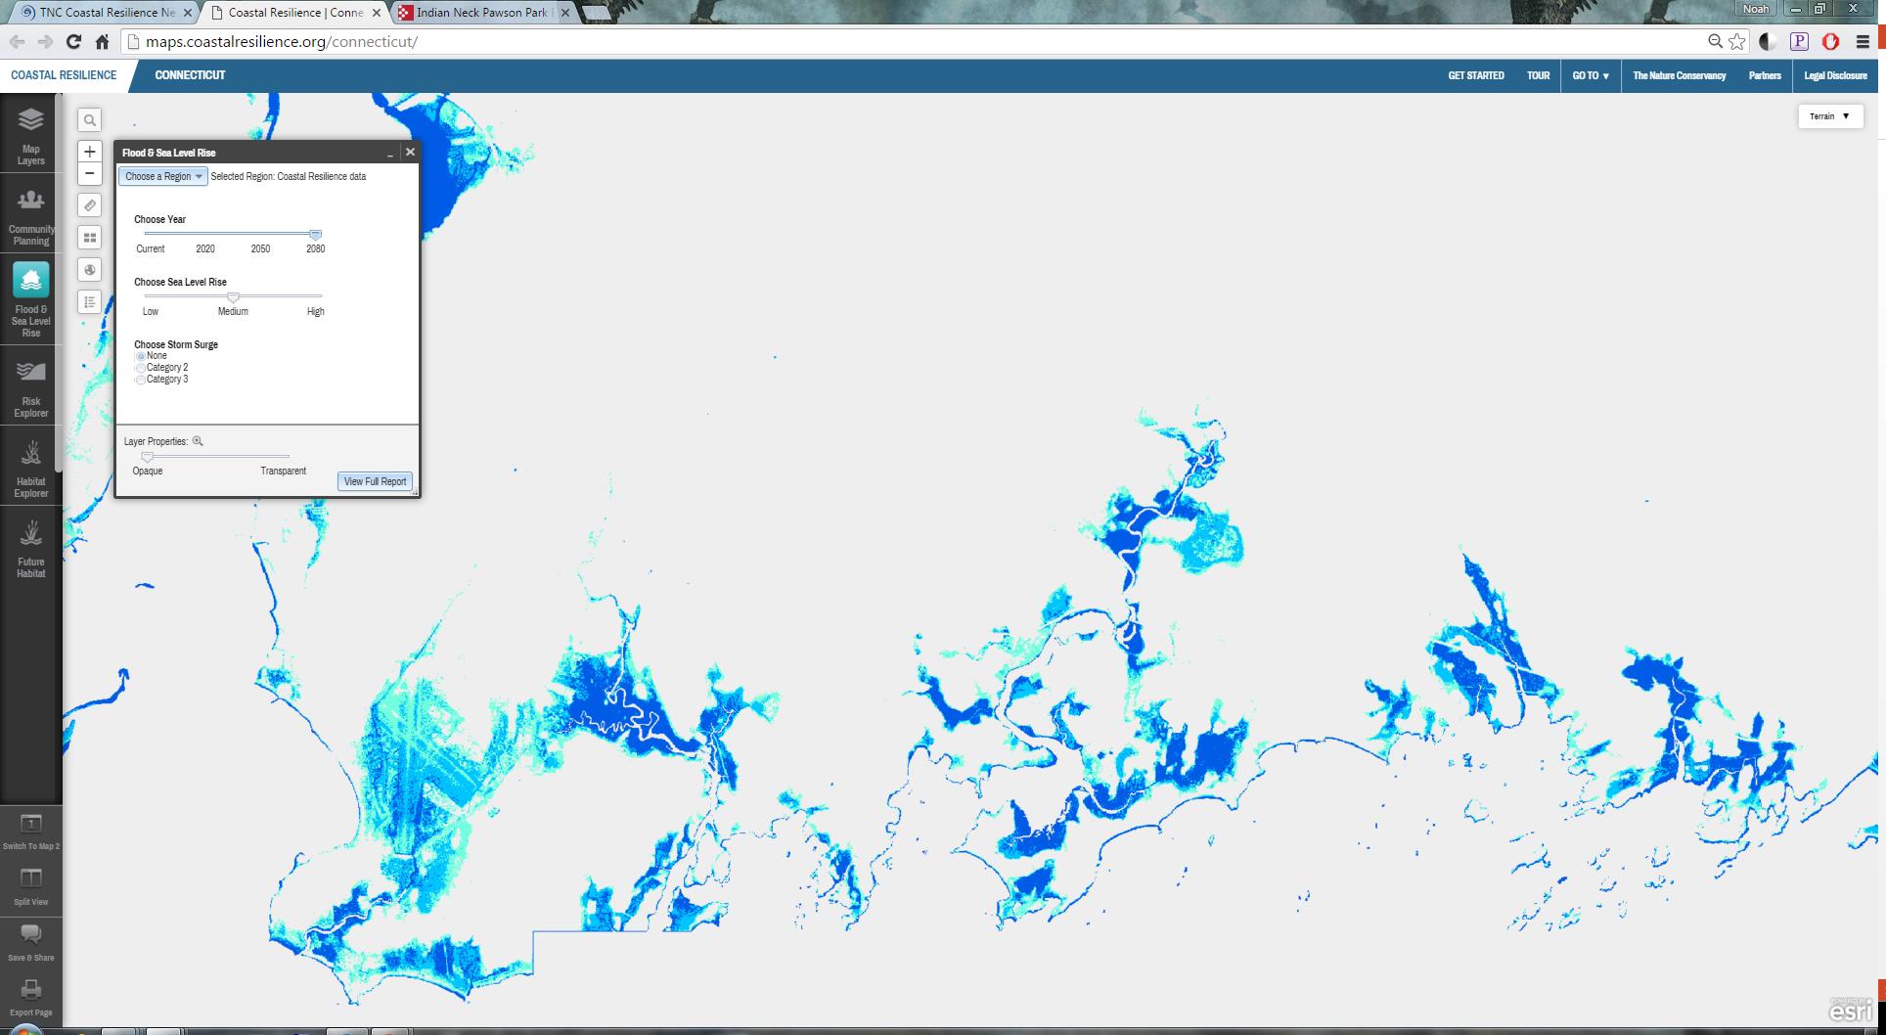
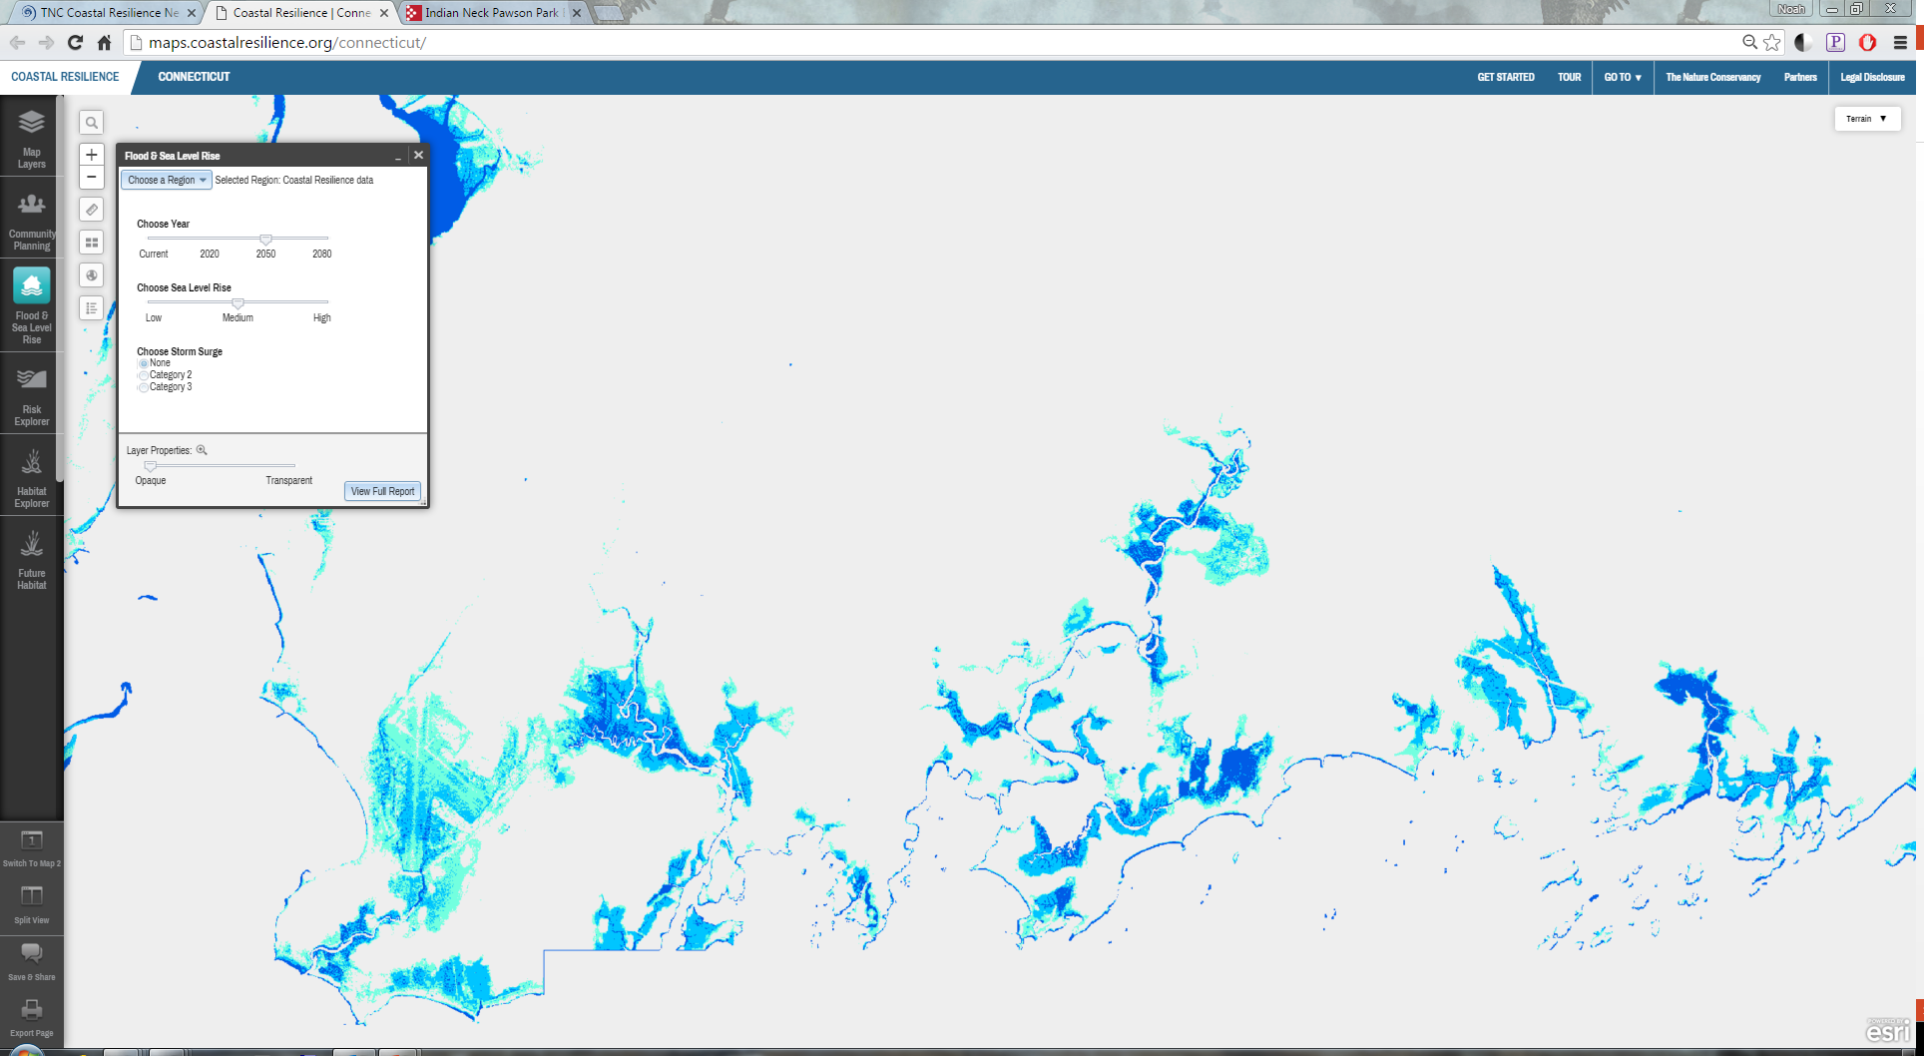
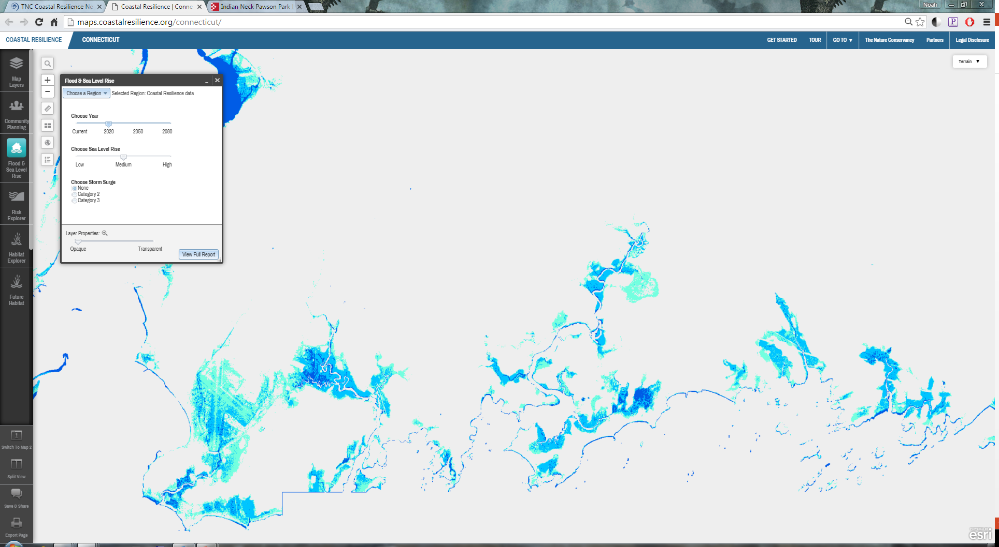
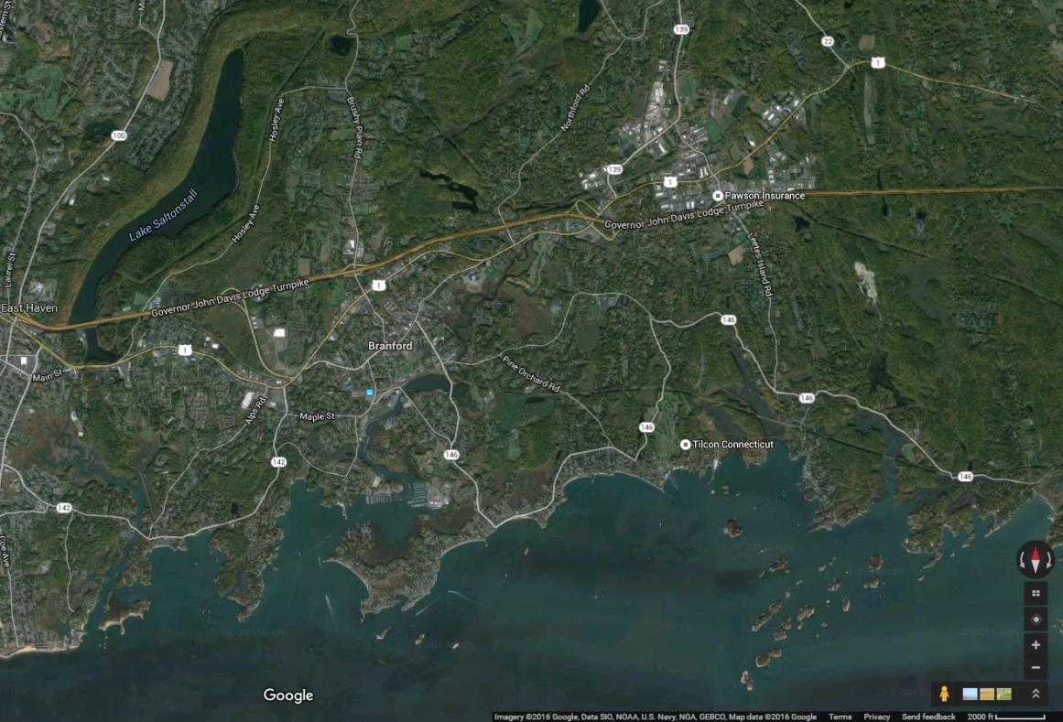
Review
Recommend
Discussion
Plan
Townwide
Access
Region
Conclusions
Next
Plans
Recommendations: Townwide
Sea Level Rise Scenarios
2020’s Daily
2050’s Daily
2080’s Daily
2020’s Cat. 2
2080’s Cat. 2

Slide 9
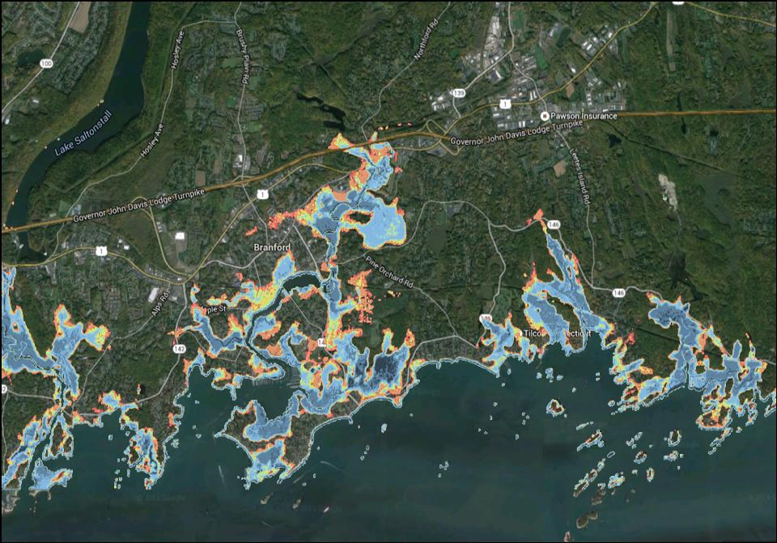
Review
Recommend
Discussion
Plan
Townwide
Access
Region
Conclusions
Next
Plans
Recommendations: Townwide
 | Shoreline Protection |  |  |  |  | Infrastructure |  |  |  |  |  | Structure |  | Realignment
 | Hard Protection | Beach Nourishment | Dune Restoration | Living Shoreline | Bioengineered Banks | Drainage | Pumping Station | Community Wastewater | Power Utilities | Road Elevation | Tide Gates | Structure Elevation | Floodproof Structures | Alternate Routes | Property Acquisition | Road Retirement
Clark Ave | X | X |  |  |  |  | X |  | X | X |  | X |  |  | X
Beckett Beach | X | X |  |  |  | X | X |  | X | X | X | X |  |  | X
Short Beach | X | X |  | X | X |  | X |  | X | X |  | X |  |  | X
Killams Point |  |  |  |  |  |  |  |  | X | X |  |  |  | X
Johnsons Point |  |  |  |  |  |  |  |  | X | X |  |  |  |  | X
Double Beach | X | X |  | X | X |  | X |  | X |  |  | X |  |  | X
Branford Point |  |  |  |  |  |  | X |  | X | X |  | X | X
Branford Center | X |  |  |  |  | X | X |  | X | X | X | X | X
Blackstone Acres | X |  |  |  |  | X | X |  | X | X | X | X
Indian Neck Ave |  |  |  |  |  |  |  |  | X | X |  | X |  |  |  | X
Sybil Creek |  |  |  |  |  |  | X |  | X | X | X | X |  |  | X
Pawson Park |  |  |  |  |  |  | X |  | X | X | X | X
Linden Ave | X |  |  | X | X |  | X |  | X
Limewood Ave | X | X | X |  |  |  |  |  | X | X |  | X |  |  | X
Haycock Point | X |  |  |  |  |  |  |  | X |  |  | X
Hotchkiss Grove | X | X | X |  |  | X | X |  | X |  |  | X |  |  | X
Pine Orchard | X | X |  |  |  |  |  |  | X | X | X | X
Juniper Point |  |  |  |  |  |  |  |  | X | X
Pleasant Point |  |  |  |  |  |  |  | X | X | X
Stony Creek | X | X |  |  |  | X |  | X | X |  | X | X | X | X
Jarvis Creek |  |  |  |  |  |  |  |  | X | X | X
Sea Level Rise Scenarios
2020’s Daily
2050’s Daily
2080’s Daily
2020’s Cat. 2
2080’s Cat. 2

Slide 10
Review
Recommend
Discussion
Plan
Townwide
Access
Region
Conclusions
Next
Plans
Recommendations: Townwide
Municipal Wastewater System
WW1 | Floodproof the Wastewater Treatment Plant
WW2 | Elevate or Floodproof Vulnerable Sewer Pumping Stations, including: Beckett Avenue Little Bay Lane Pages Central (Meadow St) Riverside Drive (Blackstone) Blocks Sybil (@ 146) Summer Island Hotchkiss Grove Clark Avenue Johnsons Point Branford Point Frank Street
Townwide Regulatory Changes
TR1 | Relax 35-ft height restriction to facilitate elevation
TR2 | Adopt freeboard that exceeds State-recommended one foot
TR3 | Apply V zone standards in coastal A zones
TR4 | Require that developers removing fill within the coastal zone analyze changes that will have on flood risk and NFIP status
TR5 | Increase Townwide tree and limb maintenance
Sea Level Rise Scenarios
2020’s Daily
2050’s Daily
2080’s Daily
2020’s Cat. 2
2080’s Cat. 2
Townwide Promotion of Property Protection
PP1 | Partner with property owners to apply for grants to elevate homes
PP2 | Promote Shore Up and similar home elevation loan programs
PP3 | Encourage homeowners to consider having the Town acquire their property

Slide 11
Review
Recommend
Discussion
Plan
Townwide
Access
Region
Conclusions
Next
Plans
Recommendations: Access
Town Roads
1 | Linden Ave
2 | Indian Neck Ave
3 | Waverly Park Rd
4 | Pine Orchard Rd
5 | Clark Ave
6 | Thimble Island Rd
7 | Harbor St
8 | Woodvale Rd
9 | Johnsons Point Rd
10 | Killams Point Rd
11 | Spring Rd
12 | Maple St
13 | Main St
14 | Ark Rd
15 | Pleasant Point Rd
16 | Pawson Rd
17 | Totoket Rd
18 | Grove St
19 | Stannard Ave
State Routes
1 | 146 @ Jarvis Creek
2 | 142 @ Short Beach
3 | 146 @ Sybil Creek
4 | 146 @ Branford River
5 | 146 @ Limewood Beach
6 | 1 @ Branford River
7 | 146 @ Stony Creek
8 | 142 @ Beckett Beach
9 | 142 @ Stannard Avenue
Sea Level Rise Scenarios
2020’s Daily
2050’s Daily
2080’s Daily
2020’s Cat. 2
2080’s Cat. 2

Slide 12
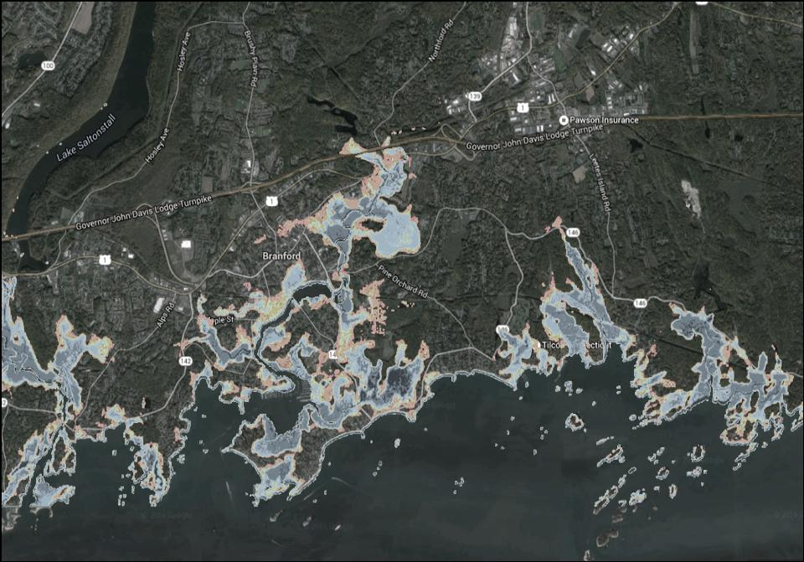
Review
Recommend
Discussion
Plan
Townwide
Access
Region
Conclusions
Next
Plans
Recommendations: Regional
Beckett Avenue Beach
BB1 | Retrofit drainage systems
BB2 | Beach nourishment
BB3 | Encourage property elevation
Meadow Street/Hammer Field
MS1 | Automatic flood gate at underpass
MS2 | Upgrade drainage system
MS3 | Elevate railroad berm over time
MS4 | Ensure substation protection
MS5 | Consider emergency shelter status
Downtown Area
DT1 | Upgrade Village Green Court drainage
Blackstone Acres
BA1 | Floodwalls to protect from future high tides
BA3 | Stormwater pumping-station
BA4 | Levee to protect from storm surge
Short Beach
SB1 | Upgrade drainage system
Sybil Creek
SC1 | Install / improve tidegate
SC3 | Home elevation on Waverly Road
SC4 | Pursue property acquisitions
Killams Point
KP2 | Construct alternative egress to Turtle Bay Drive
KP3 | Killams Point Conference Center emergency and evacuation plans
Jarvis Creek
JC1 | Assist/support resolution of tide gate problems
Indian Neck Avenue Area
IN1 | Abandon Tabor Road section
Hotchkiss Grove
HG1 | Identify where dunes and walls can be used together for flood and storm surge protection
HG2 | Retrofit drainage system
HG3 | Consider Beach Nourishment
Stony Creek Neighborhood
SC1 | Fortify Trolley Trail Bridge abutments
SC2 | Develop evacuation plan
Johnsons Point
JP2 | Upgrade Spring Road bridge
Limewood Avenue
LA1 | Stabilize Route 146
LA2 | Beach nourishment
LA3 | Dune enhancement
Double Beach
DB1 | Stabilize Lanphier Cove bank
DB2 | Pursue acquisition of VE zone properties
DB3 | Reroute sewer infrastructure over time
Pine Orchard
PO2 | Beach nourishment
Pawson Park
PP1 | Linden Avenue Bank Stabilization near Bayberry Lane
PP2 | Linden Avenue Bank Stabilization near Old Pawson Road
PP3 | Upgrade Linden Avenue drainage systems
PP3 | Develop evacuation plan

Slide 13
Review
Recommend
Discussion
Plan
Townwide
Access
Region
Conclusions
Next
Plans
Examples for Planning
Meadow Street
And
Hammer Field
Blackstone
Acres
Lanphier Cove

Slide 14
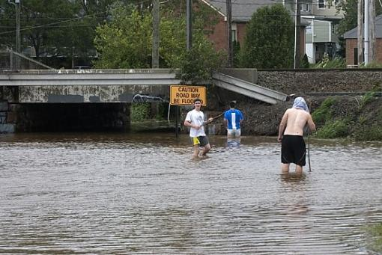
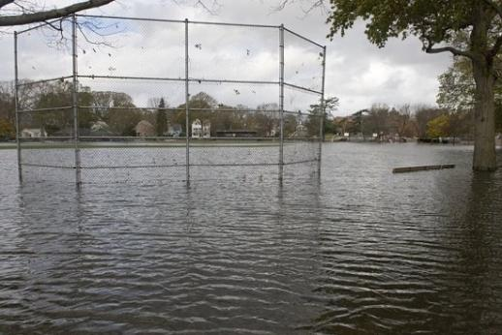
Review
Recommend
Discussion
Plan
Townwide
Access
Region
Conclusions
Next
Plans
Examples: Meadow Street and Hammer Field

Slide 15
Review
Recommend
Discussion
Plan
Townwide
Access
Region
Conclusions
Next
Plans
Examples: Meadow Street and Hammer Field
Existing Conditions
Abandon Opening
Flood Gate

Slide 16
Review
Recommend
Discussion
Plan
Townwide
Access
Region
Conclusions
Next
Plans
Examples: Meadow Street and Hammer Field
2080s DHT
gate open
2080s DHT
gate closed

Slide 17
Review
Recommend
Discussion
Plan
Townwide
Access
Region
Conclusions
Next
Plans
Examples: Meadow Street and Hammer Field
2080s
Category 2
Gate Closed
2050s
Category 2
Gate Closed

Slide 18
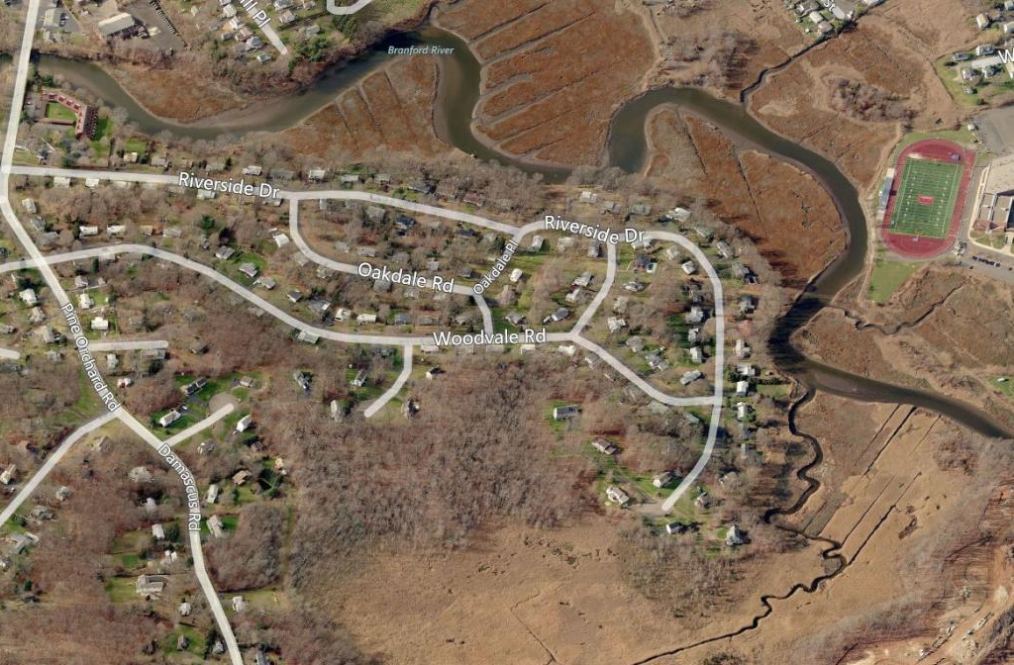
Review
Recommend
Discussion
Plan
Townwide
Access
Region
Conclusions
Next
Plans
Examples: Blackstone Acres

Slide 19
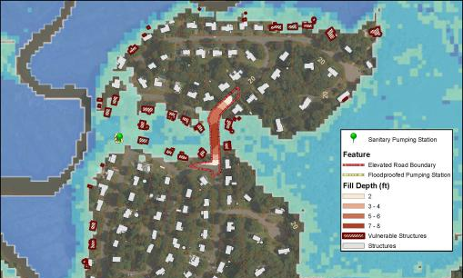
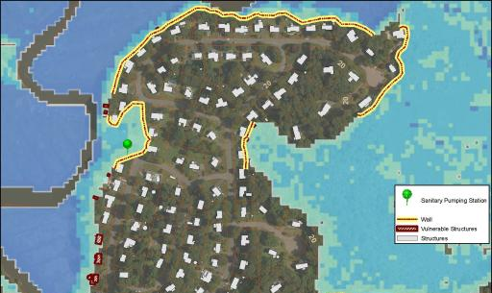
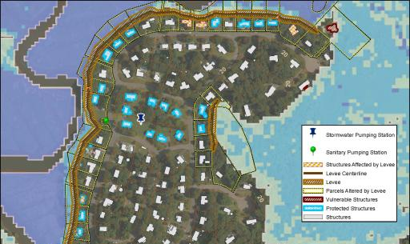
Review
Recommend
Discussion
Plan
Townwide
Access
Region
Conclusions
Next
Plans
Examples: Blackstone Acres
2080s No Storm
Floodable Neighborhood
Wall-Protected
Berm-Protected

Slide 20
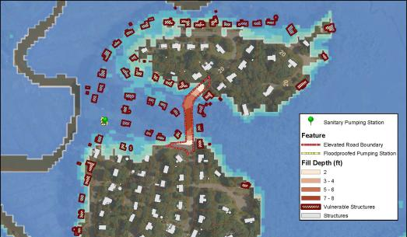
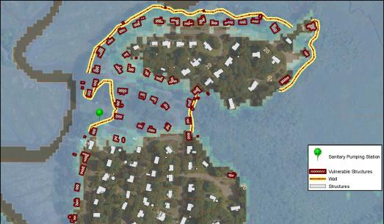
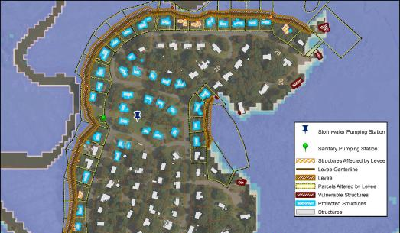
Review
Recommend
Discussion
Plan
Townwide
Access
Region
Conclusions
Next
Plans
Examples: Blackstone Acres
2080s Category 2 Storm
Floodable Neighborhood
Wall-Protected
Berm-Protected

Slide 21
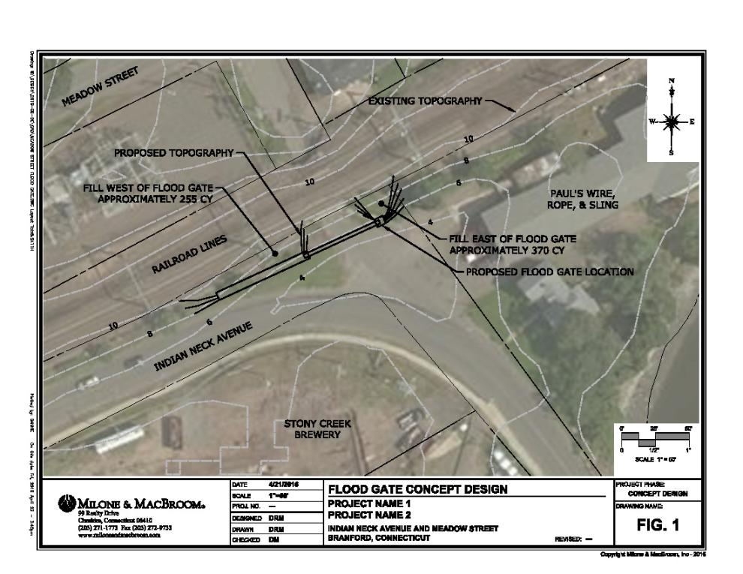
Review
Recommend
Discussion
Plan
Townwide
Access
Region
Conclusions
Next
Plans
Examples: Meadow Street

Slide 22
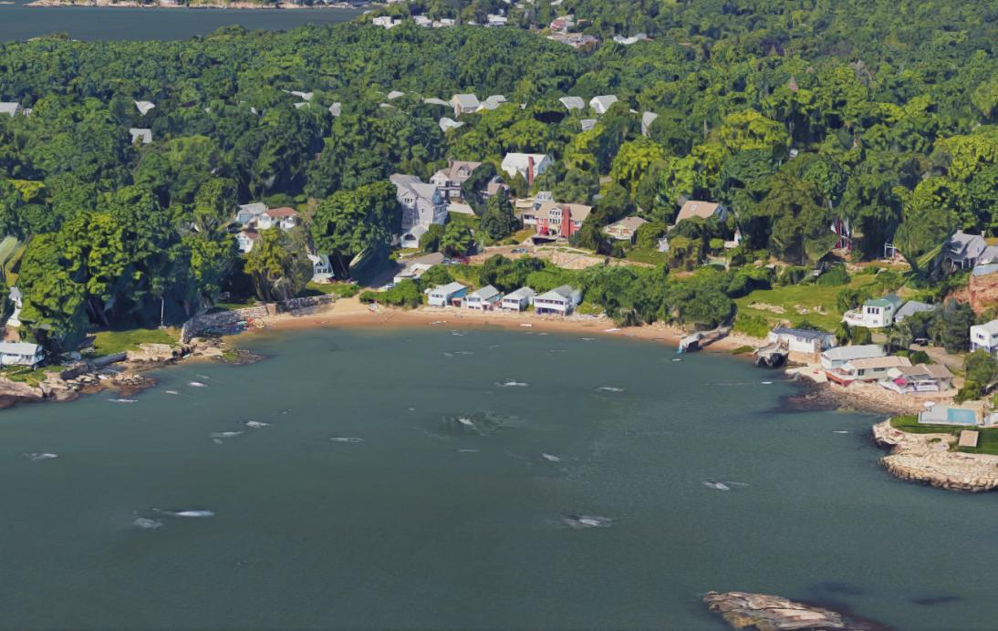
Review
Recommend
Discussion
Plan
Townwide
Access
Region
Conclusions
Next
Plans
Examples: Lanphier Cove

Slide 23
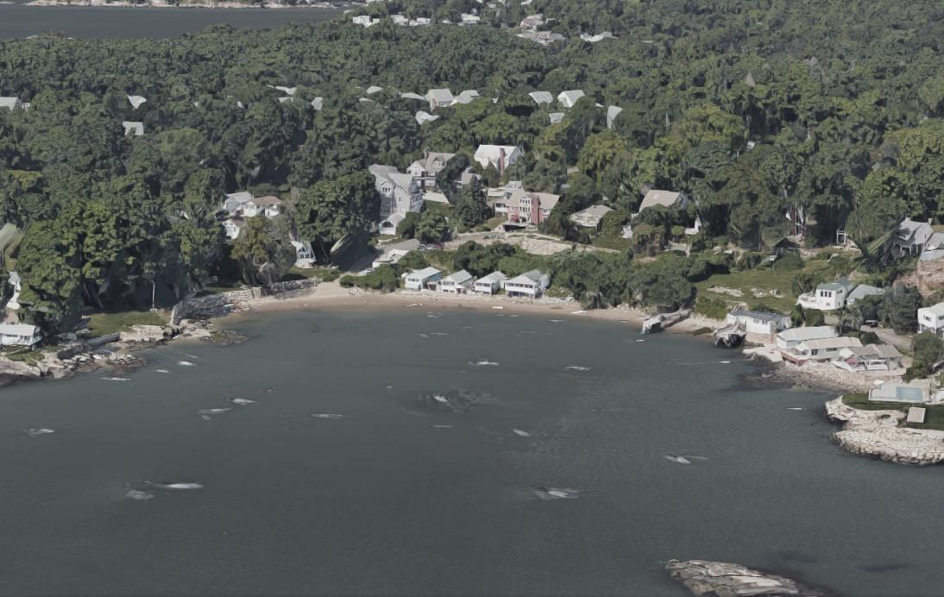
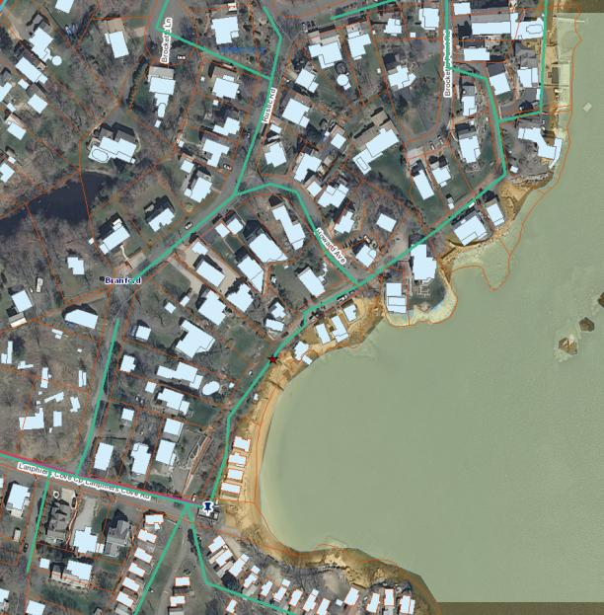
Review
Recommend
Discussion
Plan
Townwide
Access
Region
Conclusions
Next
Plans
Concepts: Lanphier Cove

Slide 24
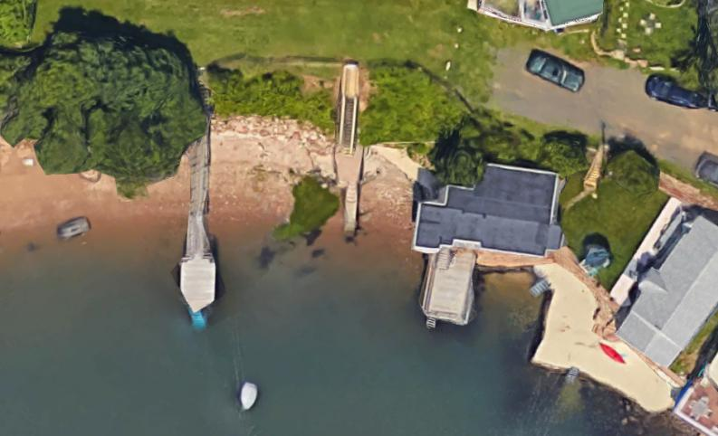
Review
Recommend
Discussion
Plan
Townwide
Access
Region
Conclusions
Next
Plans
Concepts: Lanphier Cove

Slide 25
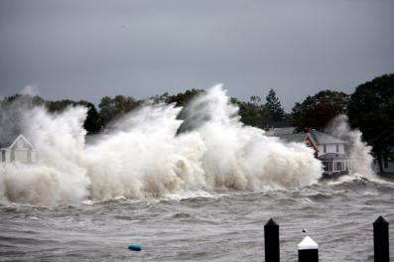
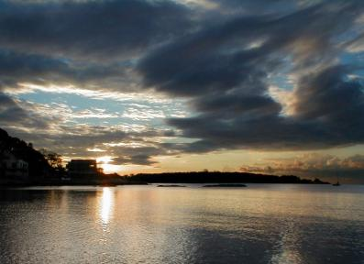
Review
Recommend
Discussion
Plan
Townwide
Access
Region
Conclusions
Next
Plans
Conclusions
Branford has the capacity to decrease vulnerabilities and therefore decrease risks
From daily high tide flooding, storm surges, erosion, and sea level rise
Branford can adapt
At the Town, neighborhood, and parcel scale
Utilities & infrastructure can be strengthened
Access can be maintained
Beaches and dunes can be nourished/restored
Drainage can be upgraded
Homes will continue to be elevated
Residents can relocate if desired
Branford has the capacity to increase its Resilience
Prepare, Adapt, Withstand, Recover
Short Beach
Image: greencitiesbluewater.wordpress.com
Short Beach
Image: Geoffrey Booth, DiegeticShadow

Slide 26
Review
Recommend
Discussion
Plan
Townwide
Access
Region
Conclusions
Next
Plans
Next Steps
Review the Draft Plan
Provide Input
Prepare Final Document
City has options for formalizing the plan:
Adopt as a stand-alone plan
Accept as a working/living document to be maintained by a commission or board
Append to Hazard Mitigation Plan
Append to Plan of Conservation and Development
Implementation
Execute existing grants from FEMA
Keep securing grants from FEMA along with CIRCA, NOAA, and others
Become more resilient!

Slide 27
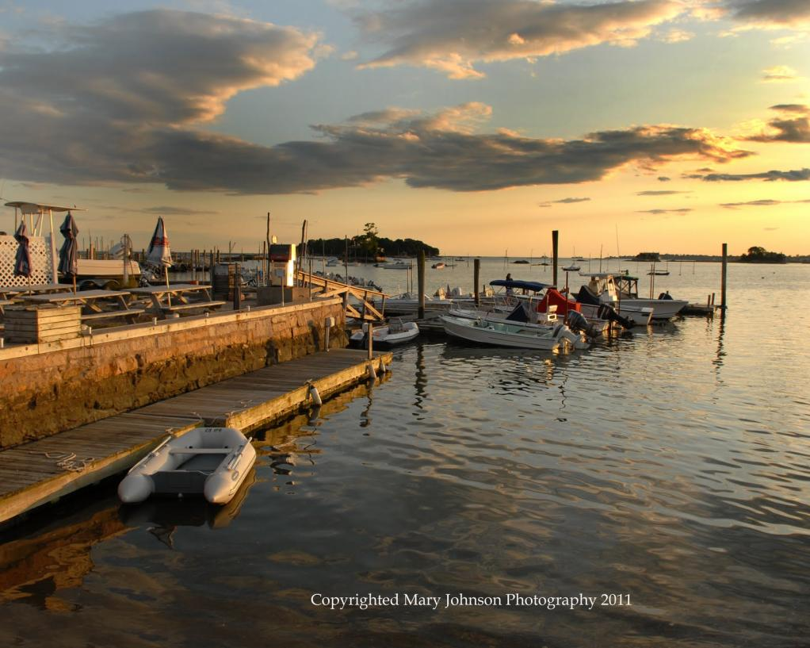
Review
Recommend
Discussion
Plan
Townwide
Access
Region
Conclusions
Next
Plans
Discussion
Stony Creek
Image: Mary Johnson Photography 2011

